Slide 1
House Price Prediction Project
Final Project – Group 2
Group members:
Nevyn Brown
Priya Sivaraj
Ros Tiamzon

Slide 2
TABLE OF CONTENTS
01
02
03
HOUSE PRICE PREDICTION PROJECT GOAL
MODELS. TECHNOLOGIES, LIBRARIES
DATA PREPARATION, EXPLORATION, CLEANING, FEATURE ENGINEERING
04
05
06
NEXT STEPS
MODEL TRAINING, TESTING AND FINE TUNING
ACHIEVING PROJECT GOAL, RESULTS & CONCLUSIONS

Slide 3
PROJECT GOAL
“Our aim is to create a predictive analysis of house prices so we can advise potential buyers or investors on sales prices and where to buy (neighborhood) based on the home features that they value most”
- Group 2
HOUSE
PRICE PREDICTION

Slide 4
MODELS, TECHNOLOGIES AND LIBRARIES
numpy
Pandas
seaborn, geoviews
sklearn
cartopy xgboost
pickle
matplotlib, hvplot,
numpy: provides comprehensive mathematical functions, used for working with arrays.
pandas: provides a plethora of useful functions that make it easy to express, analyze, and manipulate data.
matplotlib: a comprehensive library for creating static, animated, and interactive visualizations in python.
hvplot: allows for users to easily generate a wide array of plot types and interactive visualizations
cartopy: allows for georeferencing matplotlib axes objects. Cartopy’s crs class supports a variety of map projections.
xgboost: is an implementation of gradient-boosting decision trees. It has been used by data scientists and researchers worldwide to optimize their machine-learning models.
pickle: used in serializing and deserializing a Python object structure.
seaborn: a library mostly used for statistical plotting in Python, built on top of matplotlib and provides beautiful default styles and color palettes to make statistical plots more attractive.
geoviews: library that makes it easy to explore and visualize geographical, meteorological, and oceanographic datasets
sklearn: a machine learning library for the python programming language that allows for the use of multiple machine learning models, tools, and algorithms.

Slide 5
DATA PROCESSING
STEP 1: DATA COLLECTION
Collected public information on housing data
STEP 2: DATA EXPLORATION
Analyzed data, house features, correlation of house features to sales prices, analyzed numerical variables (discrete vs continuous), analyzed categorical features, distribution of sales prices
STEP 3: DATA CLEANING
Analyzed/cleansed missing data, analyzed outliers
STEP 4: HOME FEATURES ENGINEERING
STEP 5: DATA TRANSFORMATION
Analyzed rare categorical features (less than 1% removed since not adding value to sales price)
Converted categorical variables to one hot encoding, removed duplicates, prepared data for feeding into the model

Slide 6
MODEL TRAINING, TESTING AND FINE TUNNING
#4
#3
#2
BACK TESTING
xxxxx
#1
FINE TUNNING
xxxx
EVALUATING RMSE
xxxxx
XGBOOST
Xxx regression analysis

Slide 7
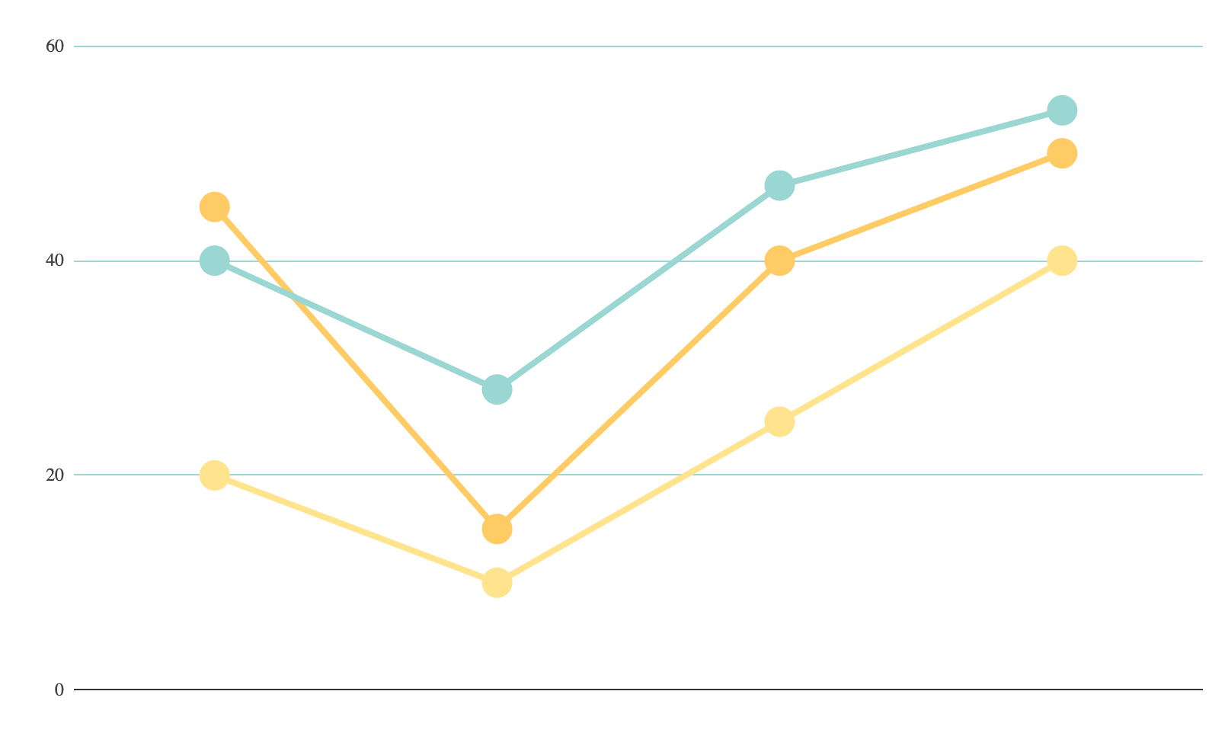
ACHIEVING PROJECT GOAL, RESULTS & CONCLUSIONS
MARS
Despite being red, Mars is a cold place, not hot. It’s full of iron oxide dust
SATURN
It’s a gas giant, composed mostly of hydrogen and helium
VENUS
Venus has a beautiful name, but it’s terribly hot, even hotter than Mercury
If you want to modify this graph, click on it, follow the link, change the data and replace it

Slide 8
WHAT’S NEXT?
POSSIBILITY OF SKYSCRAPERS OR HOUSES
A NEIGHBORHOOD
ADAPTED TO YOUR NEEDS
IN THE OUTSKIRTS OR DOWNTOWN
Neptune is the farthest planet from the Sun and the fourth-largest in our Solar System.
Mercury is the closest planet to the Sun and also the smallest one in our Solar System
Venus has a beautiful name and is the second planet from the Sun. It’s terribly hot

Slide 9
—Someone famous
“This is a quote. Words full of wisdom that someone important said and can make the reader get inspired.”

Slide 10
THANKS
Does anyone have any questions?
addyouremail@freepik.com
+91 620 421 838
yourcompany.com

